Slide 1

Think, test, search and Bruteforce : Structure a Bruteforce campagn on an OT equipment on the internet.
Notes:
Réfléchir pour mettre les reference partout

Slide 2
Summary
Introductions
Lab Setup & attack surface.
OSINT and asset detections.
Stealth mode and asset confirmations.
Observation among the competition.
Conclusion
Notes:
Mette des numéros pour définir les différentes parties.

Slide 3
Disclaimer.
This talk is intended to be informative. I strongly advise against using these techniques to break into computer systems . All content is for educational purposes only.
My personal goal was to see how easy it was to setup a real attack on a common attack vector (Credential Bruteforce).
I am not an expert in this field, the things I am going to show you have been done on my free time, if you see a mistake do not hesitate to correct it.
Notes:
Mettre des numéros sur les slide.
Ne pas surcharger les slide
Réfléchir pour ajouter plus d’image , mais bien utiliser

Slide 4
Foreword
Industrial Control System:
ICS include supervisory control and data acquisition systems used to control geographically dispersed assets
Acronyms:
SCADA : Supervisory Control And Data Acquisition
PLC : Programmable Logic Controller (meant for local use, depend on high-speed, wired connections)
OT : Operational Technologie
ICS : Industrial Control System
Notes:
Ajouter des tab et de point
Voir les fautes.
Revoir peut étre la définitions d’ICS (plus sur le contrôle de systéme phisique)

Slide 5
Local lab setup for test & POC’s
Why set up a local test environment?
Test the POC in a controlled environnement.
Greatly reduces the error rate when already tested.
Modifications for better exploitability.
Creations of detections rules.
Made some small scale governance.
Notes:
Photo de la valise. A ajouter (donne un coup en plus pour ).

Slide 6
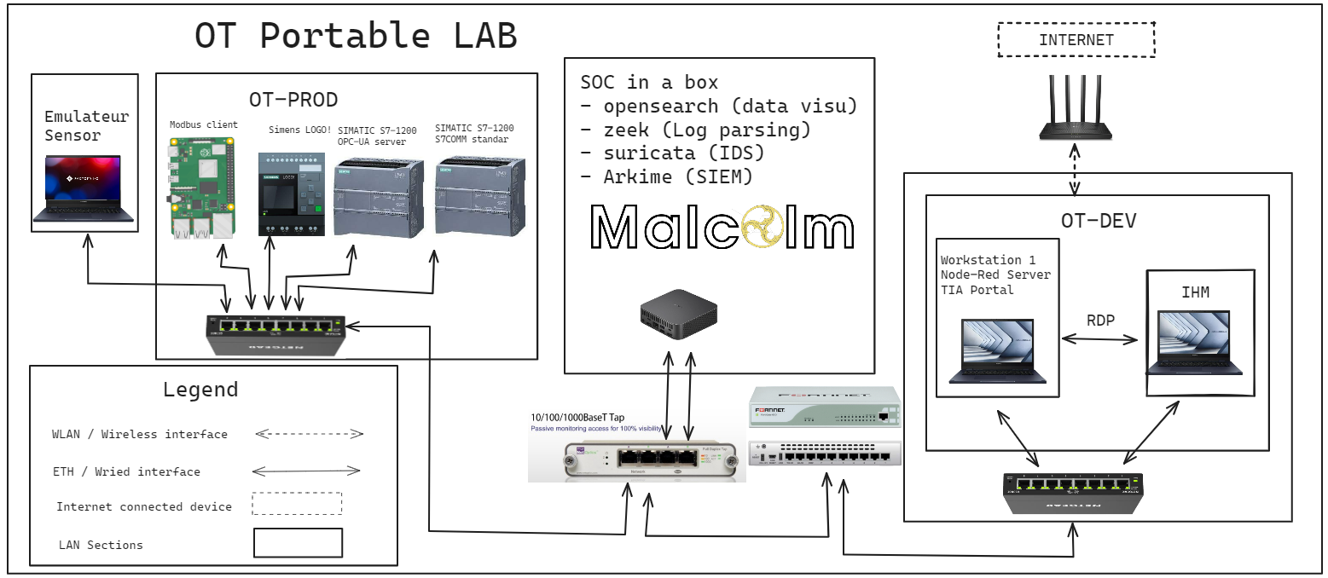
Workshop teasing.
Notes:
Enlever les adresse IP
Revoir la charte graphique de l’excalidraw.

Slide 7

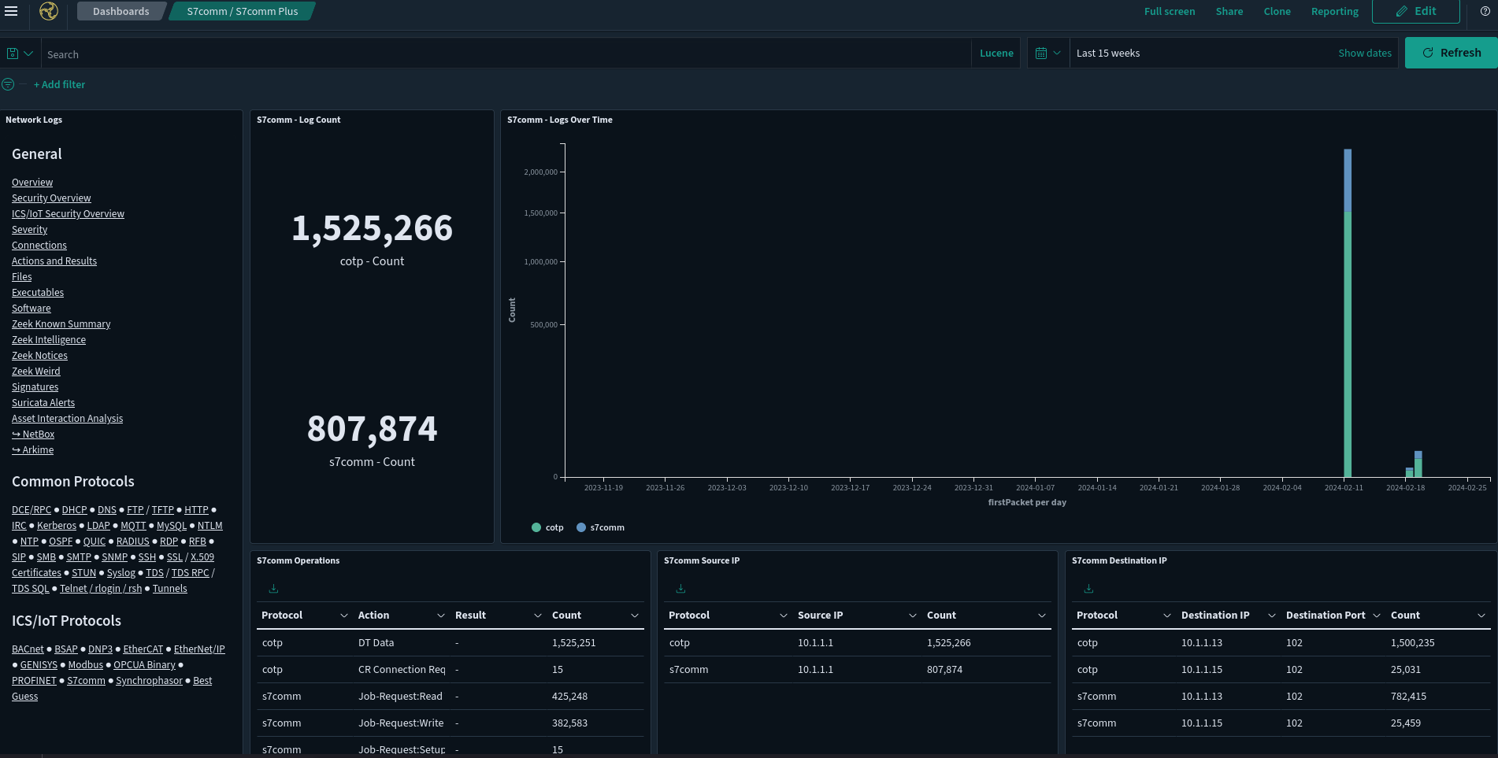
SIEM & detections

Slide 8
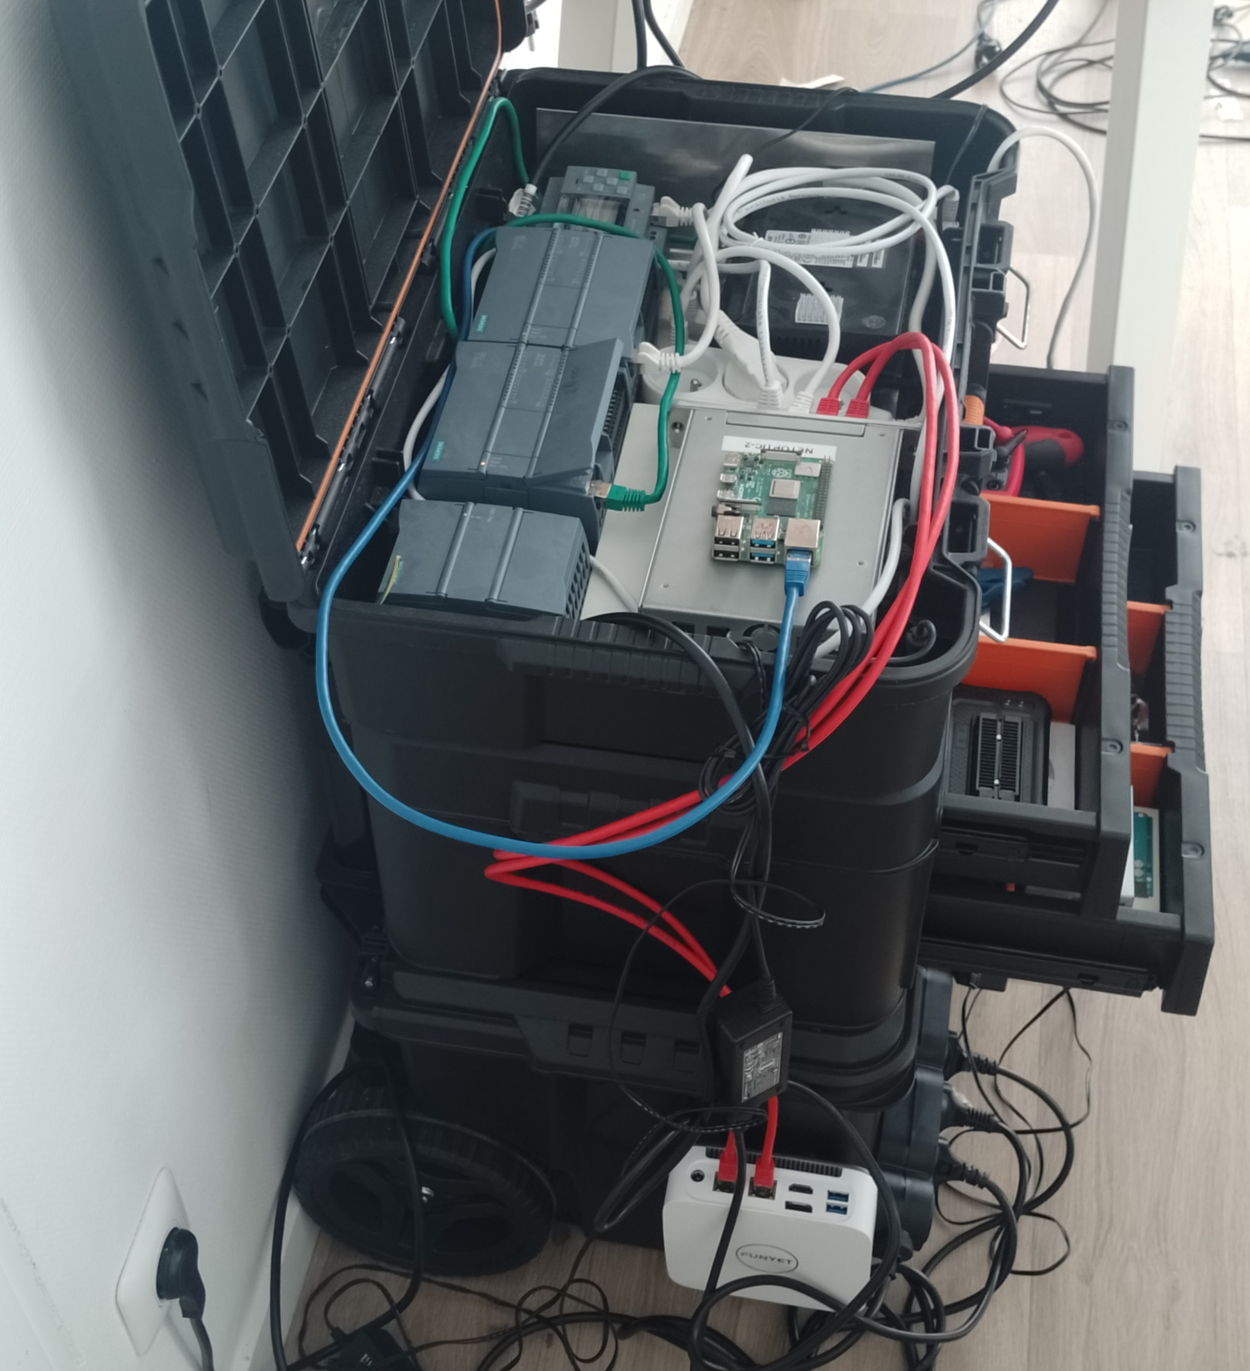
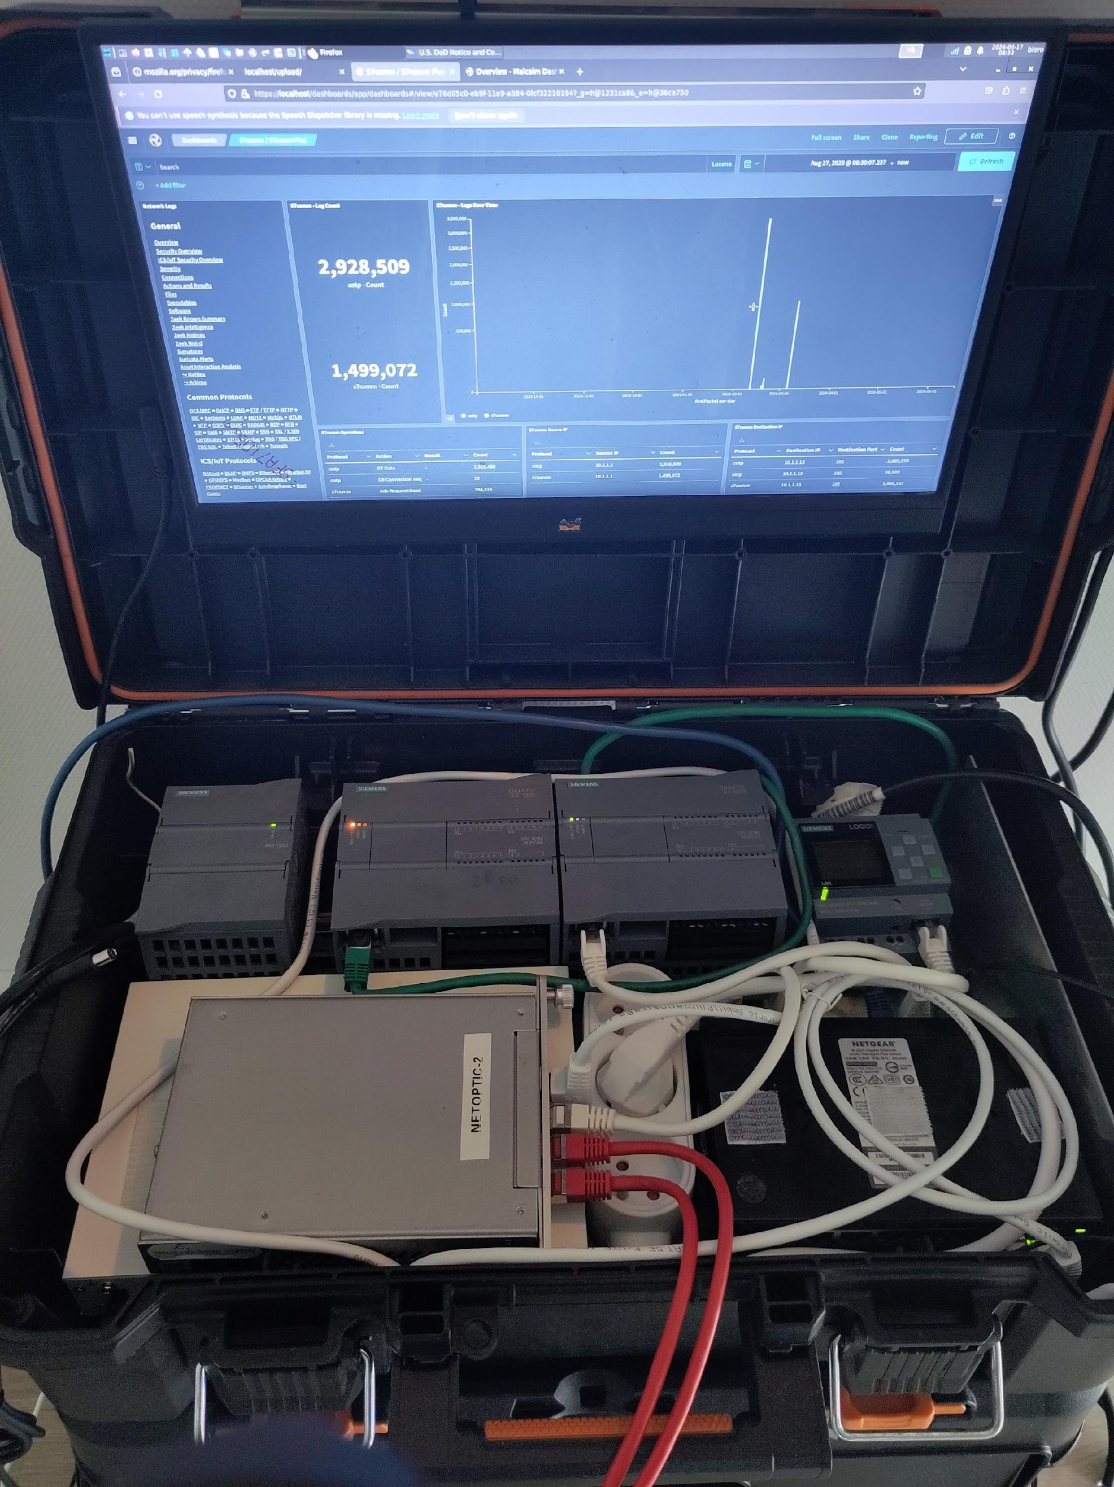
Workshop teasing.
Notes:
Enlever les adresse IP
Revoir la charte graphique de l’excalidraw.

Slide 9
Little bit of governance.
Stardard and guidance.
IEC 62443 : main series of standart for Industrial cybersecurity.
NIST SP 800-82 : NIST special publications That protide guidance for securing SCADA and DCS environement (free).
NERC CIP : standards provide a robust security foundation for the bulk electric system's critical cyber assets.
NIST 2 : come in October in eatch EU country.
Notes:
PLCs are built to be production tools used for automated manufacturing.
RTUs are monitoring tools used to prevent and detect maintenance or security issues at remote locations.

Slide 10
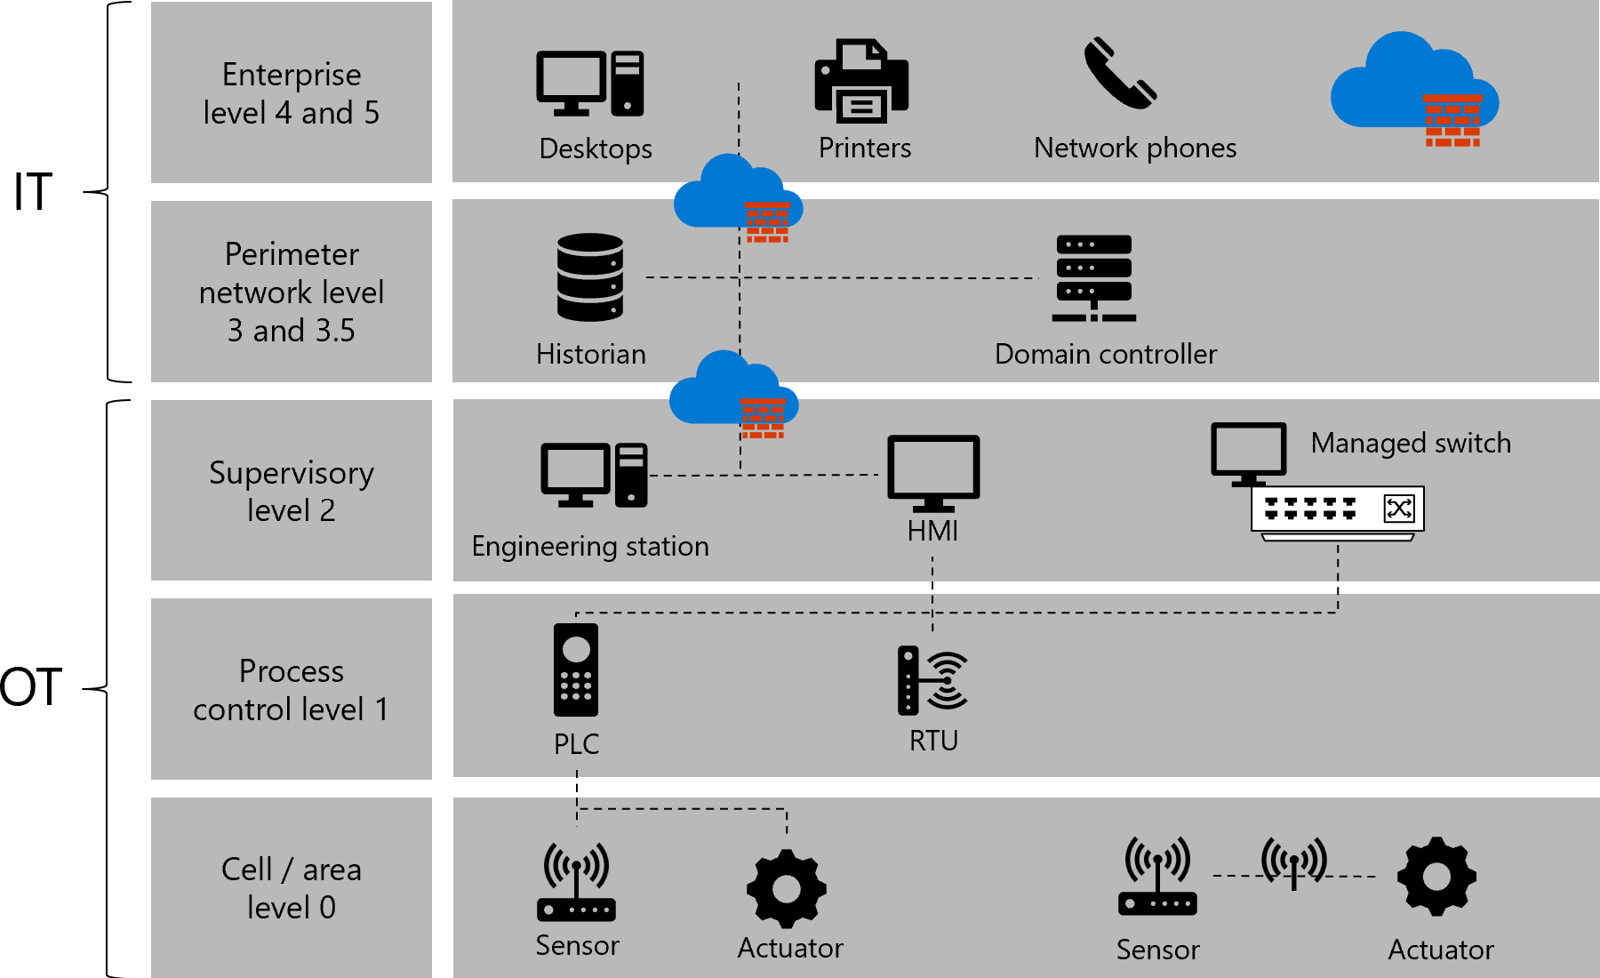
Purdue Model network view of a IT/OT network
Notes:
PLCs are built to be production tools used for automated manufacturing.
RTUs are monitoring tools used to prevent and detect maintenance or security issues at remote locations.
Modèle théorique , n’est pas applicable partout.
Le modèle evolue avec le temps ,
Exemple un capteur connecter qui et connecter directement avec le CLOUD

Slide 11
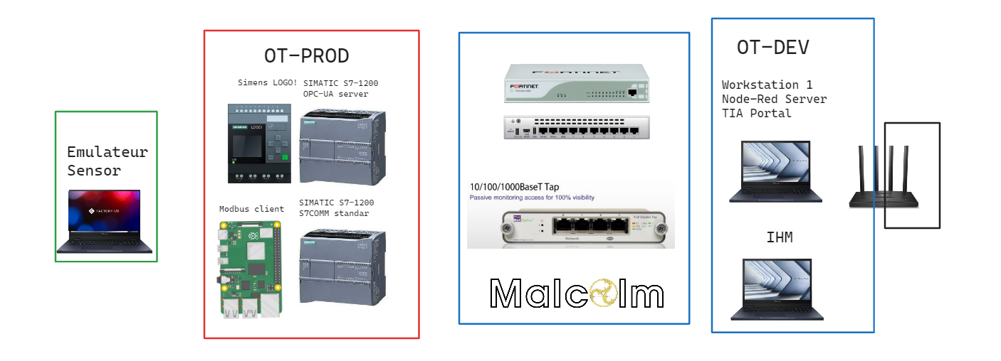
Workshop teasing.
Level 0
Level 1
Level 2
Level 3,5
Notes:
Il y a plusieurs palette

Slide 12
PLC and attack choice.

Slide 13

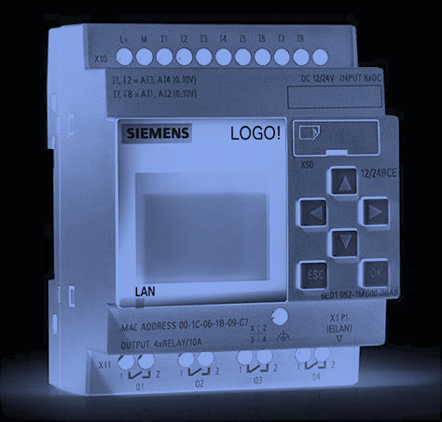

PLC and attack choice.

Slide 14
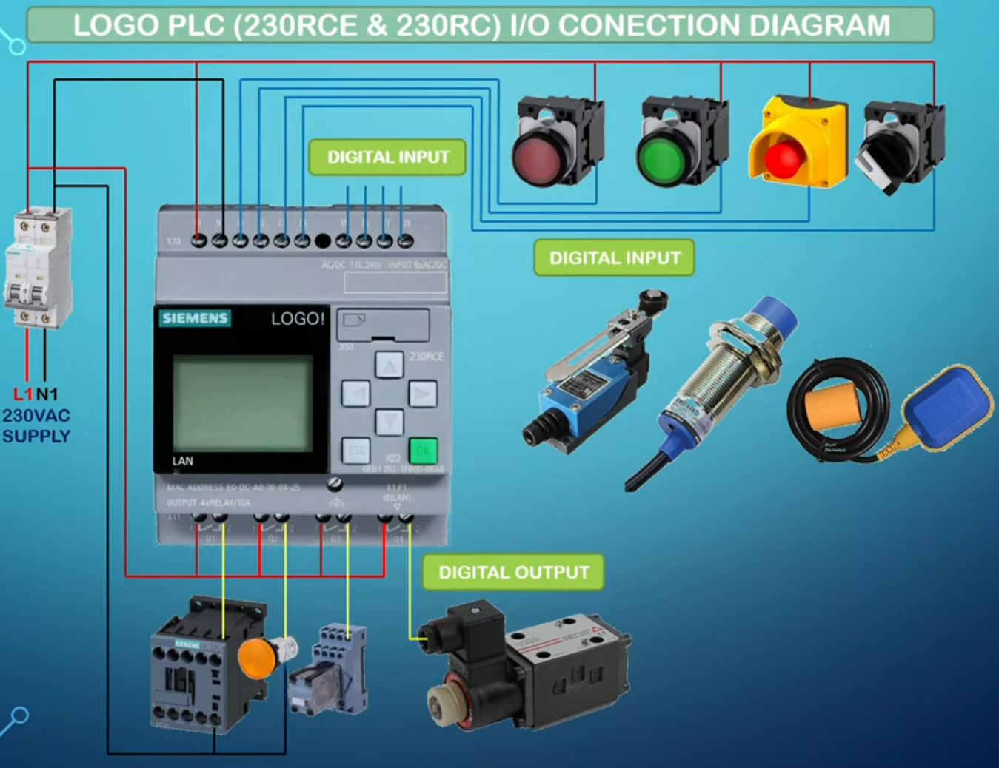
PLC and attack choice.
Always enter a circuit from output to input.
You can connect an output to several inputs, but not several outputs to one input
Notes:
Réfléchir a changer la couleur pour la rendre ^plus lisigble.

Slide 15
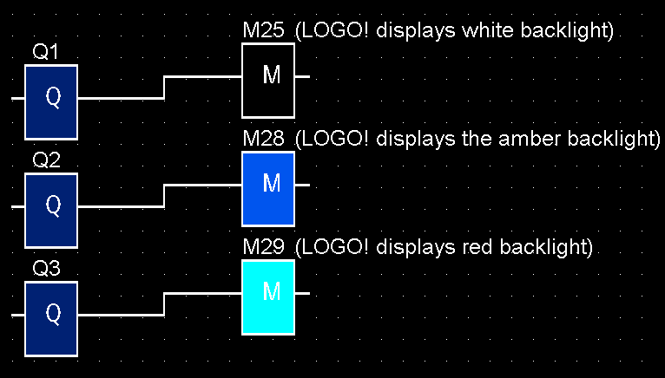
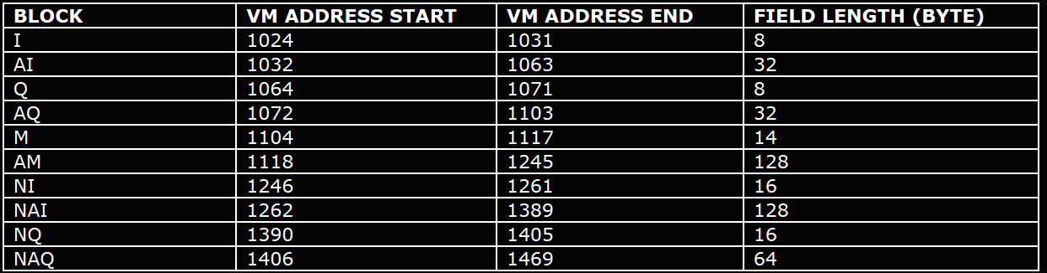
Local lab setup for test & POC’s: example
I = Imput
Q = Output
A = Analog
N = Network
M = Flag
The value is stored in pre-defined memory address.

Slide 16
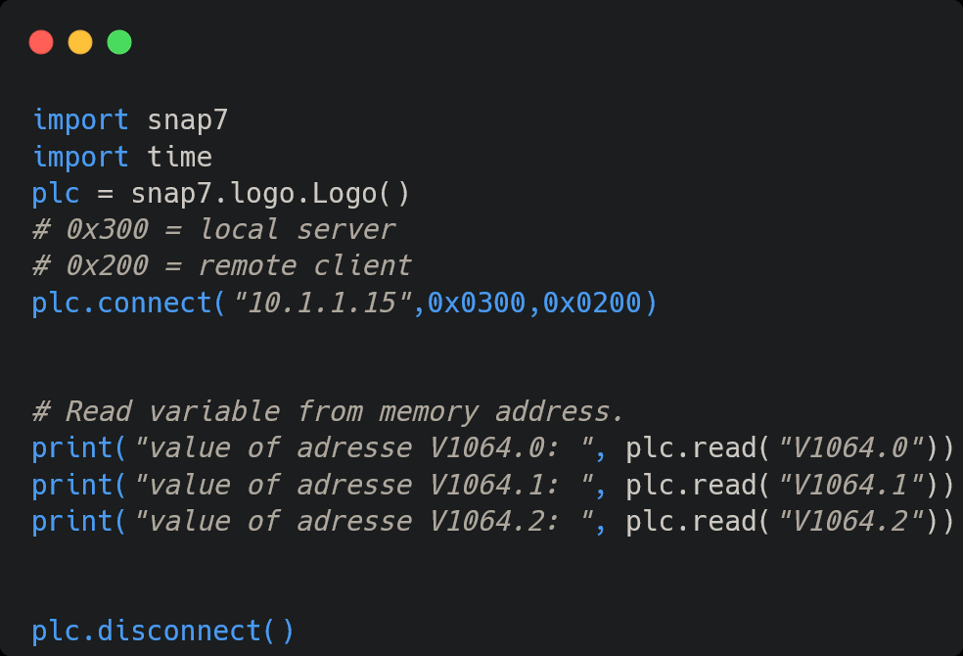

Local lab setup for test & POC’s: exemple
Snap7 is an open source, 32/64 bit, multi-platform Ethernet communication suite for interfacing natively with Siemens S7 PLCs.
Read the value from the defined memory address to see the possible behavior.
Write the value from the defined memory address to change behavior.
Notes:
Ajouter l’address dans la 1er slide. Peut étre rajouter des commentaires pour dire que les sleep sont la pour prendre en compte la lenteur du PLC.

Slide 17
Local lab setup for test & POC’s: exemple
Notes:
Ajouter l’address dans la 1er slide. Peut étre rajouter des commentaires pour dire que les sleep sont la pour prendre en compte la lenteur du PLC.

Slide 18
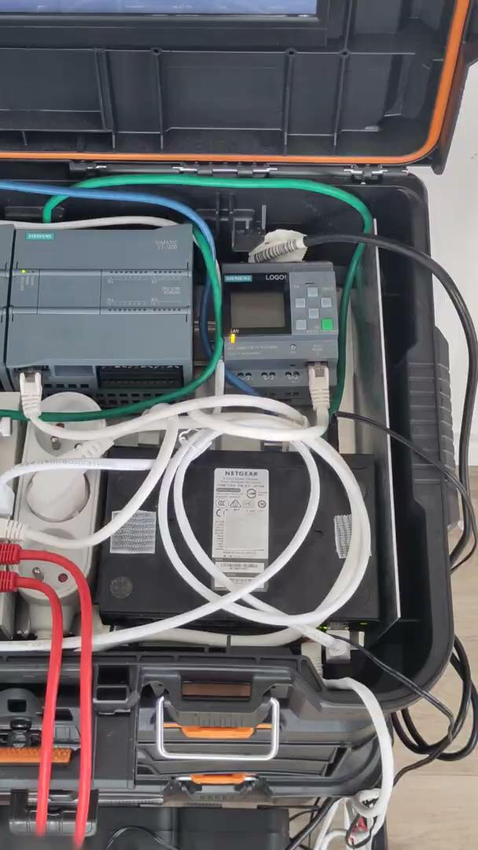
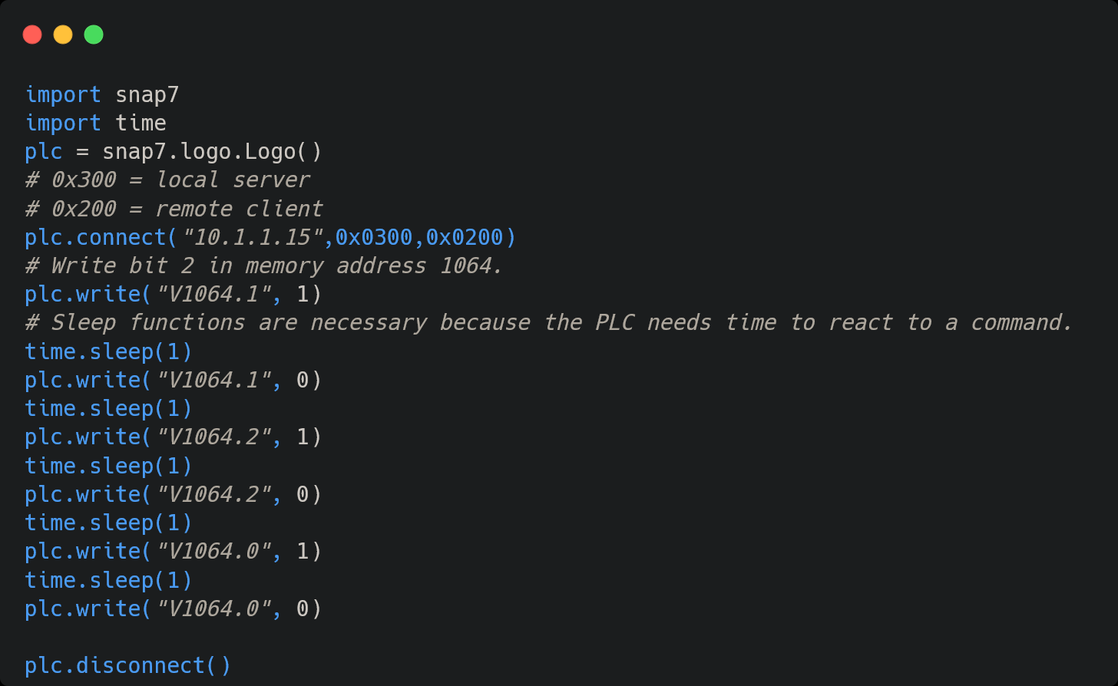
Local lab setup for test & POC’s: example
Notes:
Voir pour retourner l’image
- une partie en vue du dessus sur le LOGO
- une partie en screencast sur le PC.

Slide 19
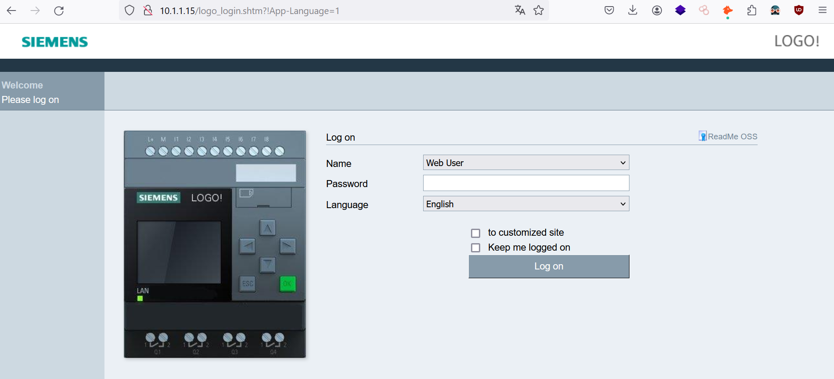
PLC and attack choice: Brute force.
Notes:
Plusieurs options
Expliquer pourquoi c’est que de l’http avent de passer

Slide 20
PLC and attack choice: Bruteforce.
1. **Random Number Generation**
- a1-a4: random number between 0 and 2^32-1
2. **Initial POST Request**
- URL: http://logo-ip/AJAX
- Header: "Security-Hint: p"
- Body: "UAMCHAL:3,4,a1,a2,b1,b2"
3. **Server Response**
- statusCode: status code from server
- loginSecurityHint: security hint from server
- serverChallenge: challenge from server
4. **PW Token Creation**
- pwToken: "password" + "+" + serverChallenge
- pwToken (truncated): truncate pwToken to max 32 characters
5. **PW Token Processing**
- crc32(pwToken): CRC32 checksum of pwToken
- loginPWToken: crc32(pwToken) ^ serverChallenge
(in uint32 form)
6. **Login Server Challenge Creation**
- loginServerChallenge: a1 ^ a2 ^ b1 ^ b2 ^ serverChallenge
7. **Login POST Request**
- URL: http://logo-ip/AJAX
- Header: "Security-Header: loginSecurityHint"
- Body: "UAMLOGIN:Web User,loginPWToken,loginServerChallenge"

Slide 21
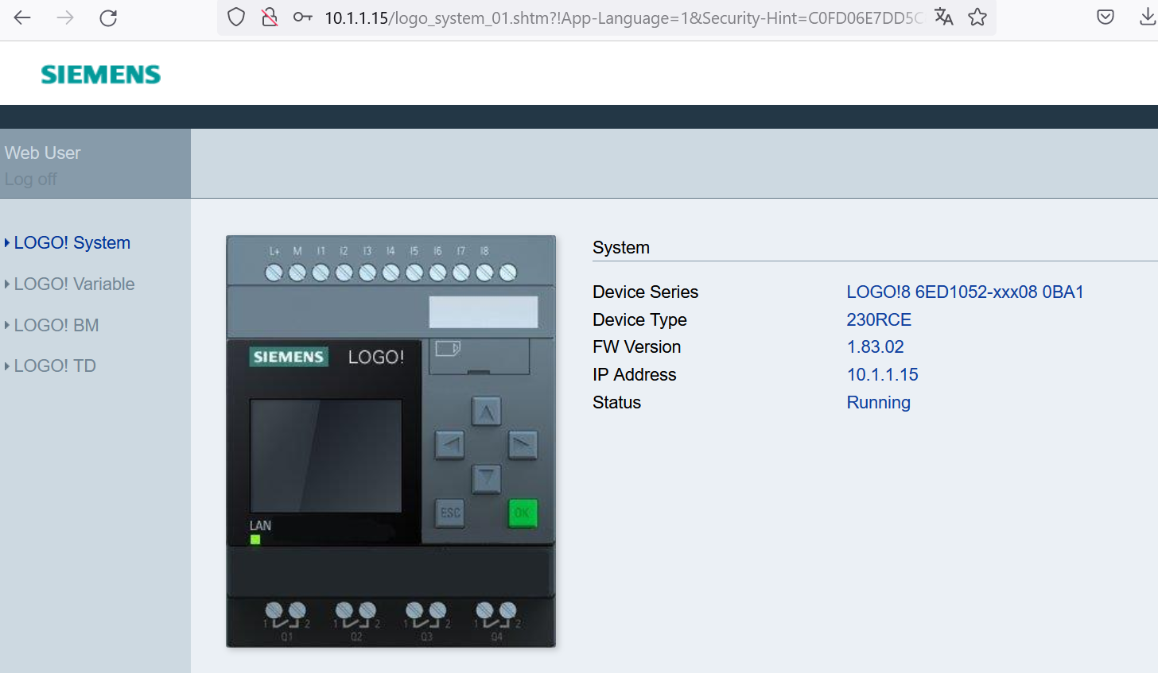
PLC and attack choice: Bruteforce.
Notes:
Ajouter une info pour dire que c’est un navigateur WEB
Adress IP:
Sa nous donne des informations pour une perios de reconnaissance.

Slide 22
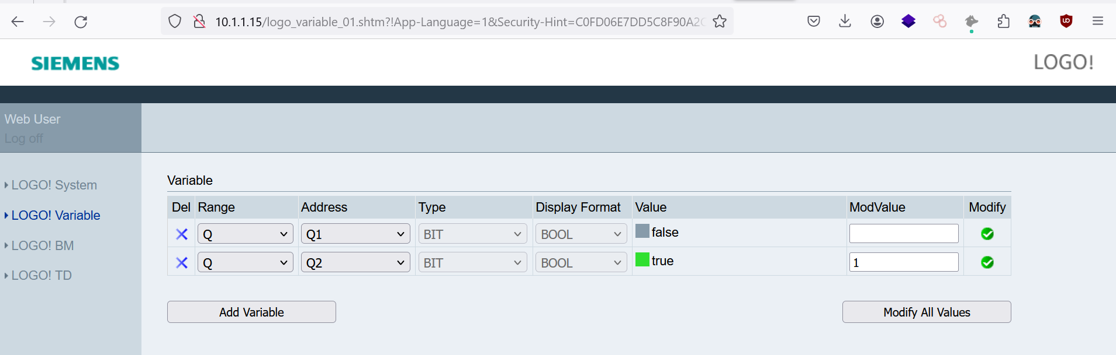
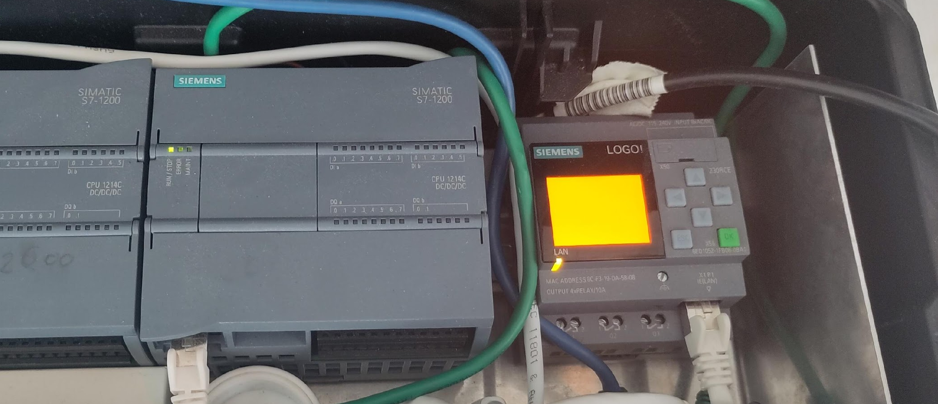
PLC and attack choice: Brute force.
Notes:
Remplacer la photo par une capture d ’écant et une photo du PLC en rouge
Bien mettre en evidence que le truc principal c’est de prendre contrôle de l’actions principale de la machine et pas forcement de la machine en elle méme

Slide 23
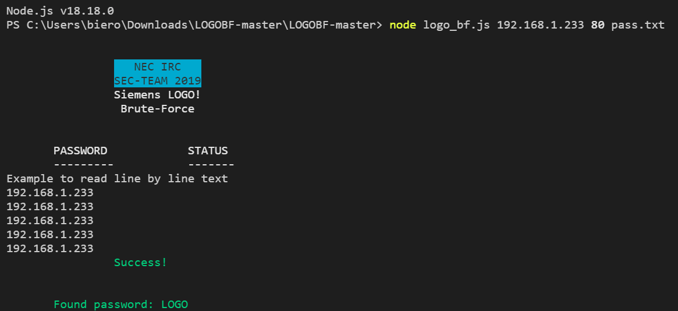
Local lab setup for test & POC’s
Thank to Yossi Reuven
I have modified the following
Add a port choise.
Improve password spray.
User choise.
This version is not public.
Notes:
Ajouter des info sur le contexte de l’output du bruteforce (capture d’écrant. )

Slide 24
OSINT and asset detections

Slide 25






OSINT and asset detections
Notes:
Peut étre grater des acces ??????

Slide 26
OSINT and asset detections
Search Methods.
Ssl fingerprinting (can’t use here cause : lack of presence of ssl certificate).
Favico fingerprint ().
Search by product (if exist).
In url , in text in body (Google).
Search by service.
Notes:
Peut étre ajoute rune image
Peut étre nommer ICS matrix plus tard

Slide 27
OSINT and asset detections
Importance of API and associated tool.
Some available tool.
Grinder (censys, shodan).
Kunyu by knowsec (zoomeye).
Uncover by project discovery (shodan , censys , FOFA , Quake , netlas ,etc…).

Slide 28
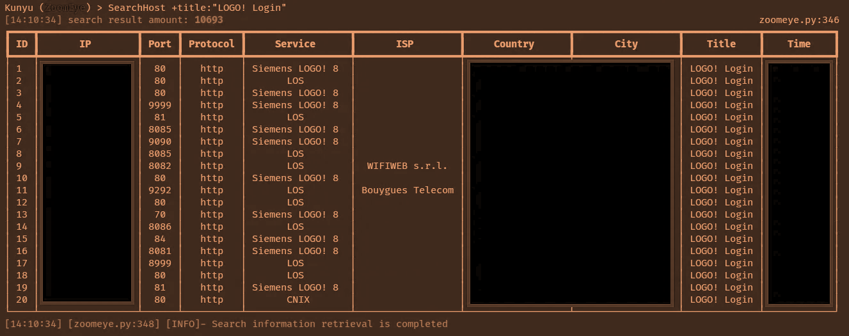
OSINT and asset detections
OUTDATED

Slide 29
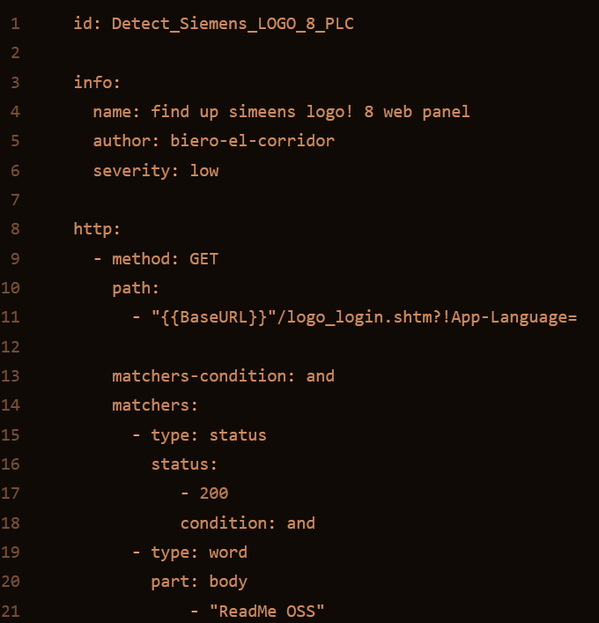

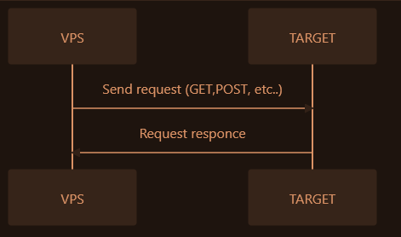
PLC and attack choice: Asset discovery.
Notes:
Voir pour appliquer une capture d’écrant classique.

Slide 30
Stealth mode and asset confirmations.

Slide 31


Stealth mode and asset confirmations.
FlokiNET
Allow tor exit node to be hosted.
VPS can be hosted in non EU, US (the good guy) RU,CN (the bad guy)
ISO can be selected.
Accept monero and bitcoin
Dont give money to russia, china or uncle sam.

Slide 32


Stealth mode and asset confirmations.
Mullvad say’s:
We announce that we have completely removed all traces of disks being used by our VPN infrastructure!
On the monero side:
The United States Internal Revenue Service (IRS) has posted bounties for contractors that can develop Monero-tracing technologies.

Slide 33
Stealth mode and asset confirmations.
Steps.
Buy monero (kraken will not let you withdraw your monero in less than 3 day).
Buy and install mullvad (5 simultaneous uses).
Buy a flokinet VPS (preferably located in iceland).
Install an iso (ubuntu 21, mullvad won't work on a lower version).
Install mullvad on the VPS.
Start spraying.
Notes:
Peut étre faire un schéma pour expliquer les différente sections

Slide 34
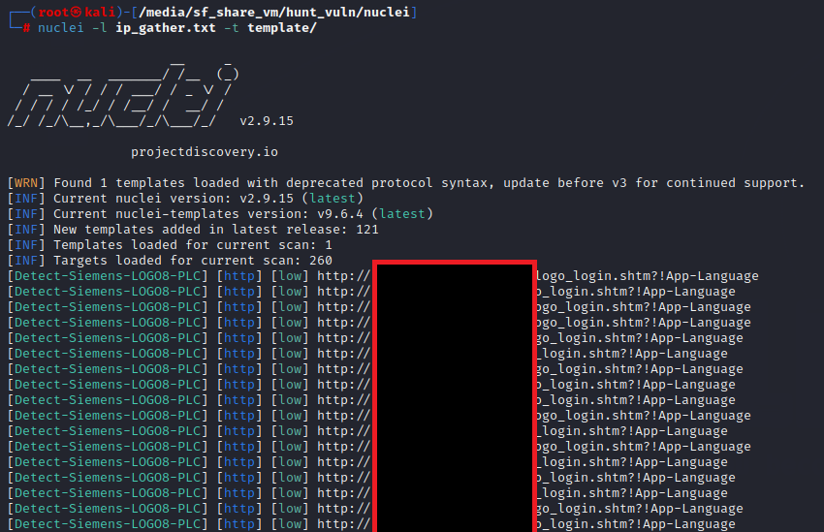
Stealth mode and asset confirmations.
180 asset from around the world found with only one base search query
Notes:
Mettre une source juridique pour expliquer que c’est legal.

Slide 35


Slide 36
Observation among the competition.

Slide 37
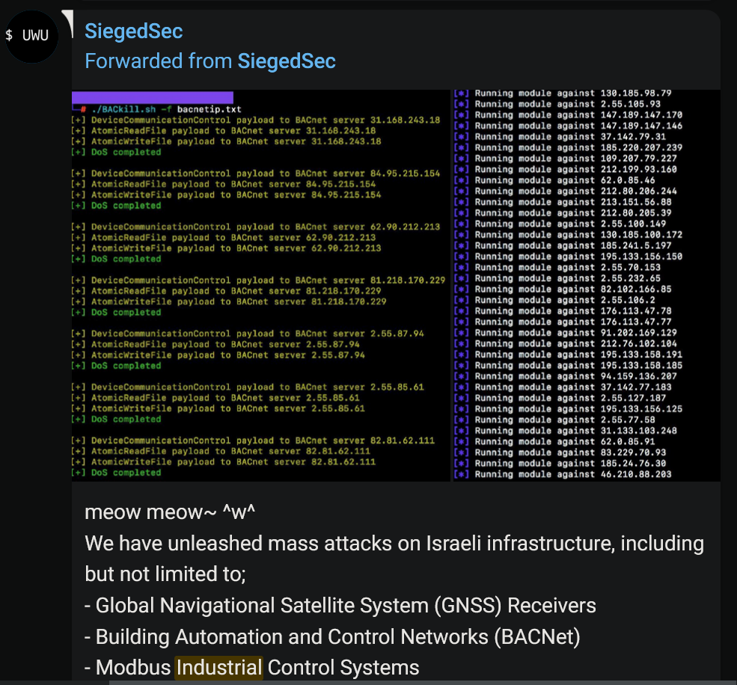

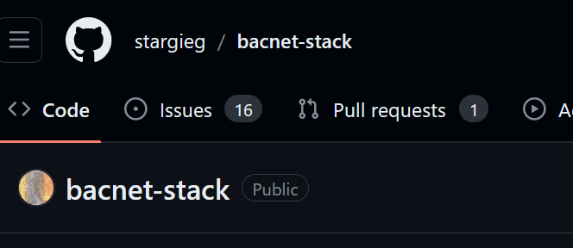
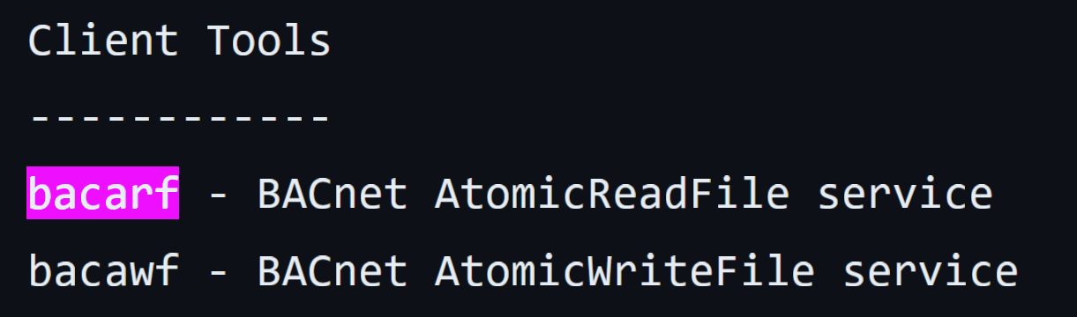
Level 1: DoS

Slide 38
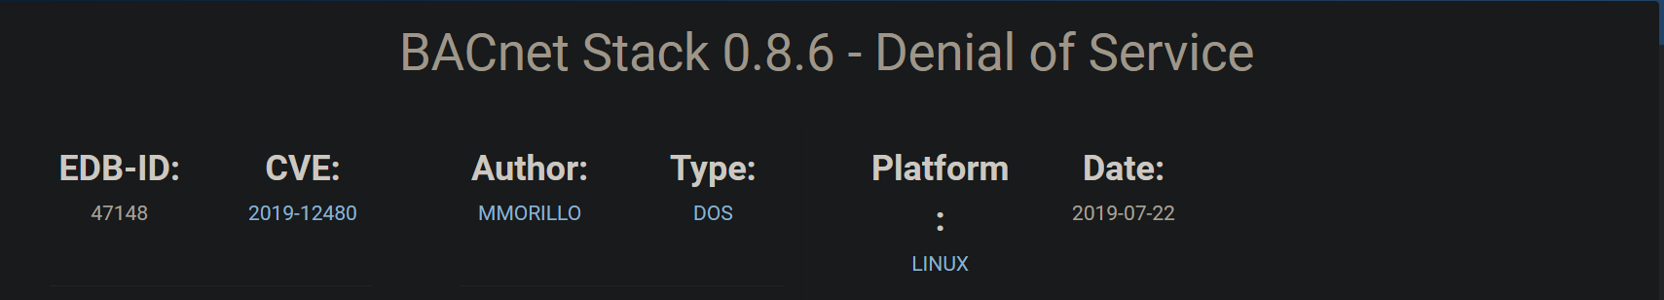
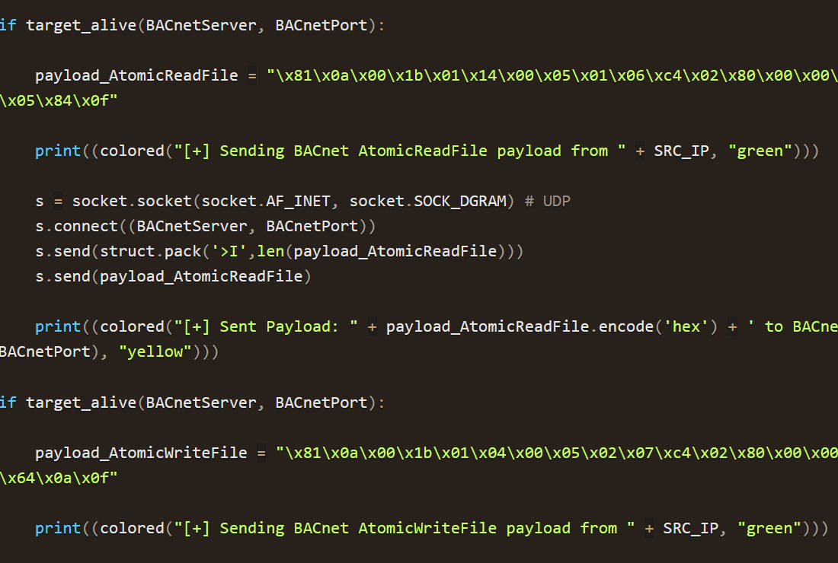


Slide 39
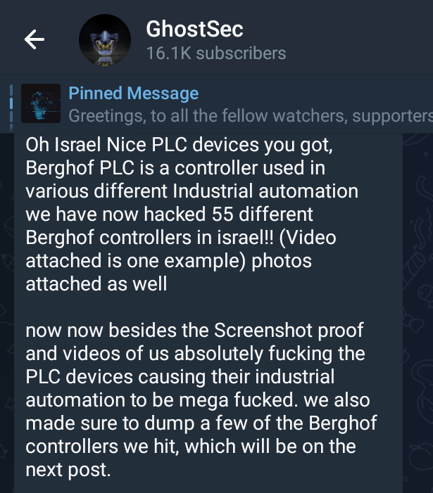
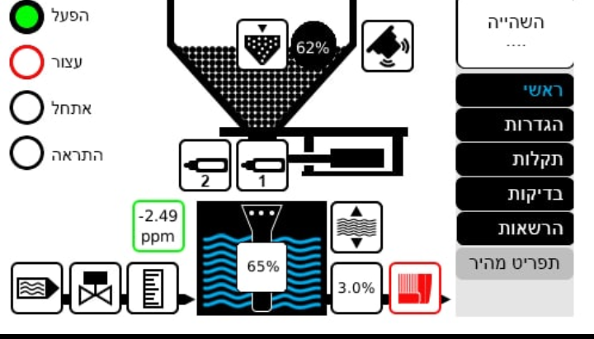
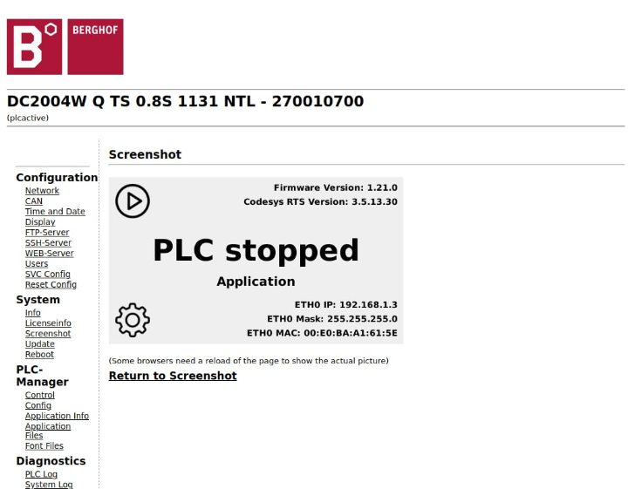
Level 2: Access Control + dump
Notes:
Ou comme j’aime l’appeler : Bruteforce wit extra step

Slide 40

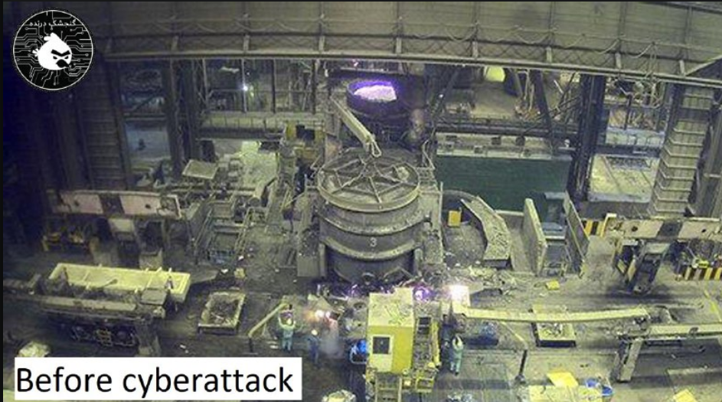
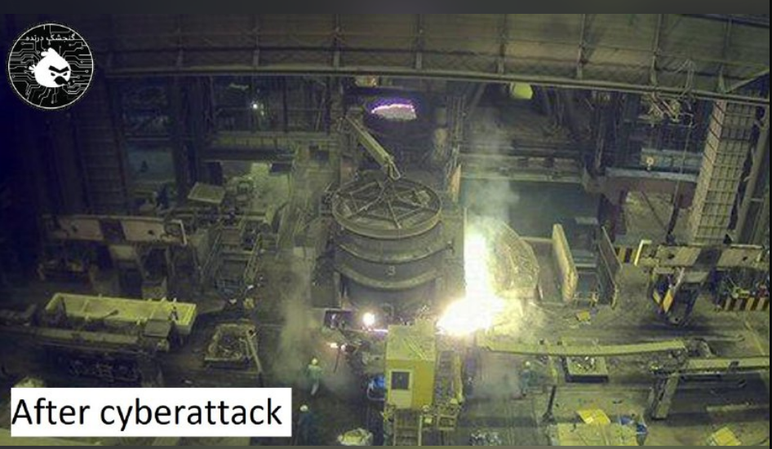
Level 3: to good to be true ?

Slide 41
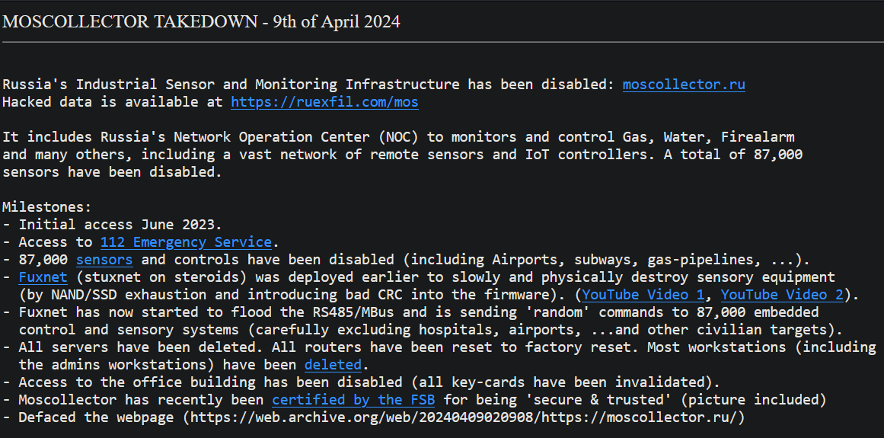
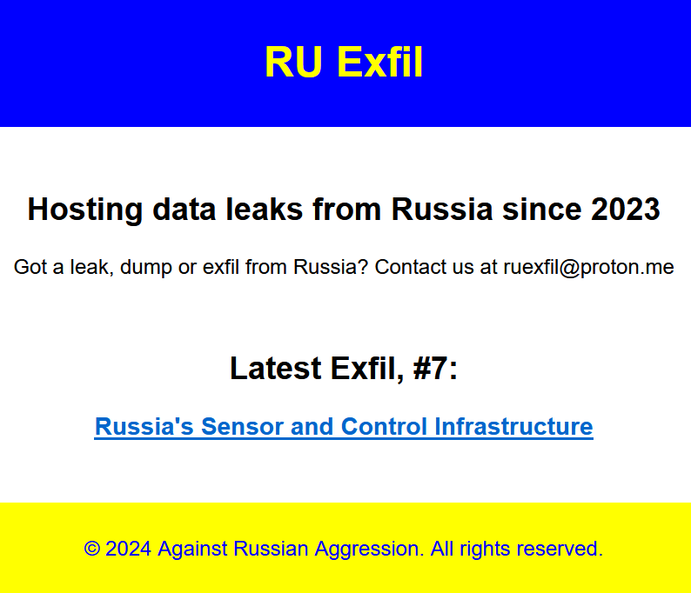
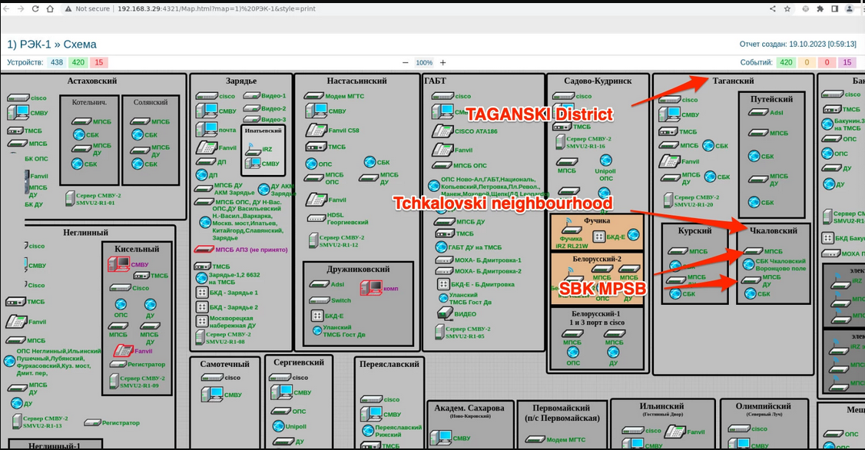
Level 4: state sponsor

Slide 42
Conclusions
It all started because I was curious seeing hacktivist saying he’s targeting PLC.
Lots of them are just honeypots and the rest is a mix between swimming pool management system, poorly maintained smart switch but sometimes important stuff.
If there was only one thing to remember, it will be:
If a PLC is front facing internet the Iranian, Russian, Chinese, American and furry will exploit it before you.
Notes:
Rendre le truc plus edulcorée.
Les moment ou je prend positions , c’est les moment ou je suis rue de moi.
Ajouter des animations pour le texte

Slide 43
More
https://github.com/biero-el-corridor/OT_ICS_ressource_list
https://github.com/biero-el-corridor/LOGO_BRUTE_FORCE_BUNBLE
https://github.com/biero-el-corridor/Chall_cretation
https://www.icsrank.com/ (list of query for ip browser)
This month Hackable.
If you can star the repos, or follow me on github you will help me lot, thanks !!!!!!!!!!!
Notes:
Ajouter la sections pour le hackable magazine
Et vendre le workshop de l’aprem.

Slide 44
Thanks to
CYBERICS || GITHUB : HTTPS://GITHUB.COM/CYBERICS/
Ecole2600 || Lionel AUROUX VINCI Energies Systèmes d'Information
Notes:
Ajouter une image

Slide 45
Questions.
Notes:
Ajouter une image

